Slide 1

HPC Roary Cluster
Management Nodes –
Part 2 – xCAT Management

Slide 2
HPC Management Nodes
Master Nodes:
Active Master Node: HPCxCaT
Used for:
Slurm Workload Manager (Open-source Job Scheduling System)
xCAT - Extreme Cloud Administration Toolkit, open-source distributed computing management software developed by IBM
Hardware:
2 nodes x Dell R630
56CPU / 256 GB Memory
Current OS installed
same configuration on both nodes
Currently running CentOS7.8 (64bit) across the cluster
One Local Partition: / (420 GB)
Additional mounts come from the Lustre FS: /home & /scratch
Notes:
xCAT (Extreme Cloud Administration Toolkit) is open-source distributed computing management software developed by IBM

Slide 3
Role of xCAT
Role of xCAT -
Remotely Manage Systems:
Remotely manage systems via ILO/DRAC
OS provisioning: login/compute nodes (Alma9 x64bit) in parallel (diskful, diskless) via PXE boot
Control and maintain servers’ RPMs, configuration files in parallel via postscripts, initiate remote commands
Uses additional services for provisioning OS:
-TFTP (load OS via PXE boot)
-DNS (name resolution in the roary.net domain)
-DHCP (IP assignment with MAC)
-Maintain /etc/host file
-Local Repository in the cluster

Slide 4
xCAT Installation
Installation Guideline
xCAT:
https://xcat-docs.readthedocs.io/en/stable/
Pre-requisites:
-Make sure NTP is enabled across the cluster
https://github.com/xcat2/xcat-core/wiki/XCAT_2.13.3_Release_Notes
https://xcat-docs.readthedocs.io/en/stable/guides/install-guides/yum/manual_install.html
-Passwordless SSH for root is enabled across the cluster from ms1/ms2
-Configure a VIP network interface dedicated for the active xcatmaster
-VIP for xcatmn: 192.168.248.60 (em3:0) only up on active master node
-Host IP for ms1: 192.168.248.61 (em3) | ms2: 192.168.248.62 (em3)
-ms1/ms2 configured as ntp, nameservers on xcat
-xcatmn used as dhcp server, dns server, tfpserver in mgmt network
-roary.net domain used

Slide 5
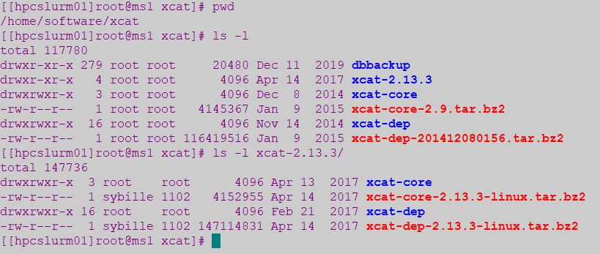
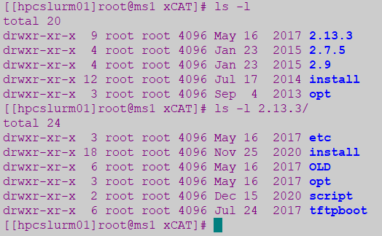
xCAT Installation
xCAT Installed under Lustre FS:
Tar downloaded under /home/software/xcat/
On active master node mount these xcat partitions from lustre
Installation launched from Xcat-core / xcat-dep repositories
Installation prefix path: /home/share/xCAT/2.13.3

Slide 6
xCAT stop/start scripts
xCAT stop/start scripts:
Manually stop/start xCAT on master node (ms1/ms2)
xCAT script to stop/start xCAT daemons located under /bin/
-stop-xcatmn > /home/share/xCAT/2.13.3/script/stop-xcatmn
This will stop/start xCAT daemons, dhcp, unmount lustre, stop/start VIP NIC interface em3:0
xCAT daemon is xcatd
-start-xcatmn > /home/share/xCAT/2.13.3/script/start-xcatmn

Slide 7
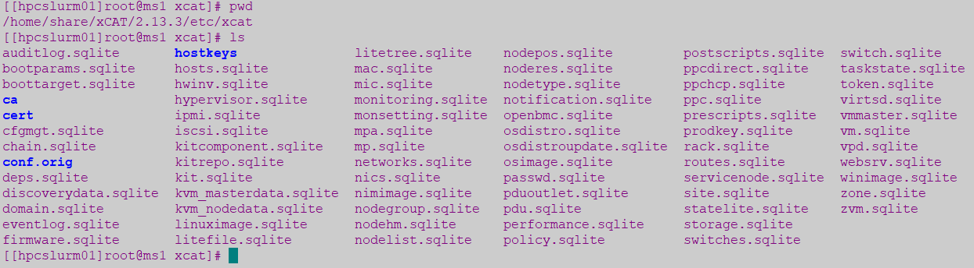
xCAT Configuration
xCAT Configuration Files:
Lustre Location: /home/share/xCAT/2.13.3/etc/xcat
xCAT configurations are stored in multiple tables on the SQLite DB – located under /etc/xcat (mount from lustre)

Slide 8
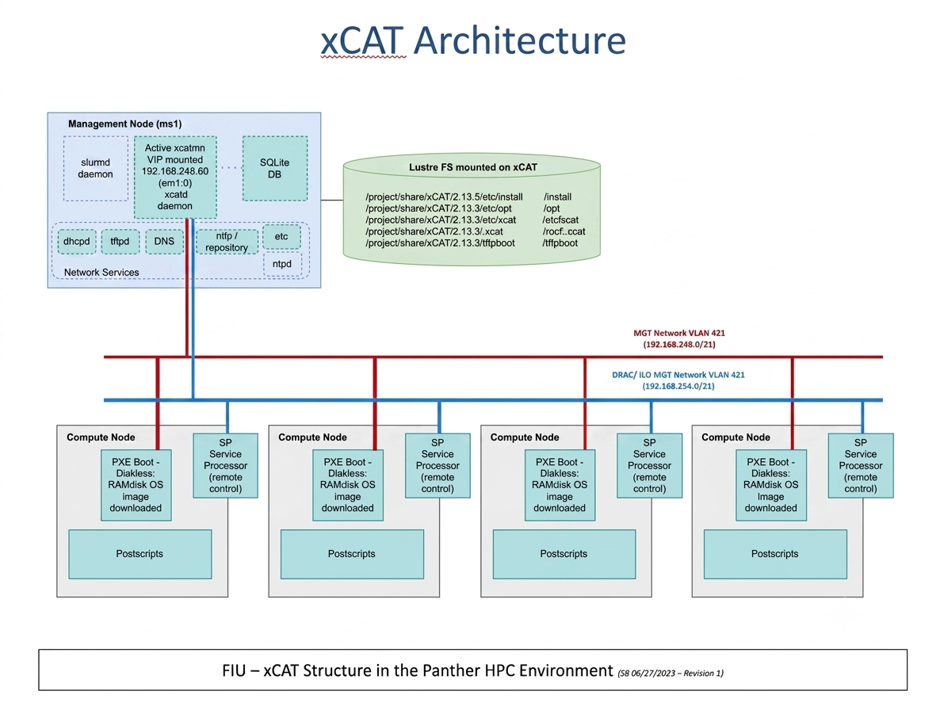
xCAT Architecture
xCAT Architecture
FIU –xCAT Structure in the Roary HPC Environment (06/03/2026- Revision 2)

Slide 9
xCAT – Basic Concepts
xCAT Basic Concepts:
xCAT Objects (has 20 Types): most important are node, group, osimage objects
Global Configuration: some configuration must be set before starting using xCAT on the site, policy, passwd and networks table
xCAT Network: requires understanding of the network in order to be able to centrally managed the servers remotely
xCAT Database: All data for the xCAT Objects and global configuration are stored in xCAT Database
Notes:
https://xcat-docs.readthedocs.io/en/latest/guides/admin-guides/basic_concepts/xcat_db/index.html
https://xcat-docs.readthedocs.io/en/latest/guides/admin-guides/basic_concepts/xcat_object/index.html

Slide 10
xCAT – Manipulate DB Tables/Objects
Manipulate
xCAT DB Tables:
tabdump: Display headers and all rows of table in CSV format
tabedit: Open table in edit mode in flat CSV format and save changes with :wq (like vi)
tabgrep: List table names in which an entry for the given node appears
Sample: tabdump site | tabedit site | tabgrep n055 | chtab node=node1 nodelist.groups=all
chtab: Add/delete/update rows in the database tables
Manipulate
xCAT Oject Definitions:
lsdef: List data object definitions
mkdef | chdef | rmdef: Create/Change/Remove data object definitions
nodels: List node group, list the nodes and their attributes
nodeadd | nodech | noderm: Add/Change/Remove node attributes from DB
Sample: nodech node1-node4 groups=all | chdef -t node -o node01 groups="all"
Helpful Commands:
man tablename: Get detail info on columns and table definitions (or use tabdump -d tablename)
man xcatdb: Complete reference
Sample: man object_type | table_name | man mkdef
Notes:
https://sourceforge.net/p/xcat/wiki/Listing_and_Modifying_the_Database/#node-group-support-in-the-xcat-tables
https://xcat-docs.readthedocs.io/en/latest/guides/admin-guides/references/man7/group.7.html

Slide 11
xCAT - Global Configuration
Global Configuration:
site: Global settings for entire cluster (tabdump site)
policy: Controls who has authority to run specific xCAT operations (ACL)
passwd: Contains default userids and passwords for xCAT to access cluster components used during config/install and for SP (bmc)
networks: Contains the network definitions in the cluster

Slide 12
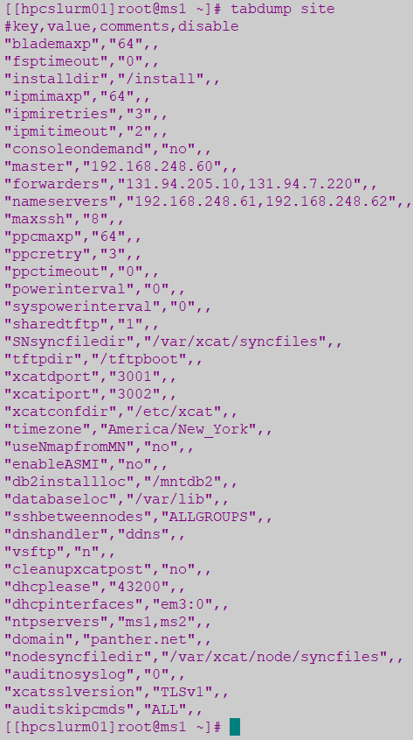
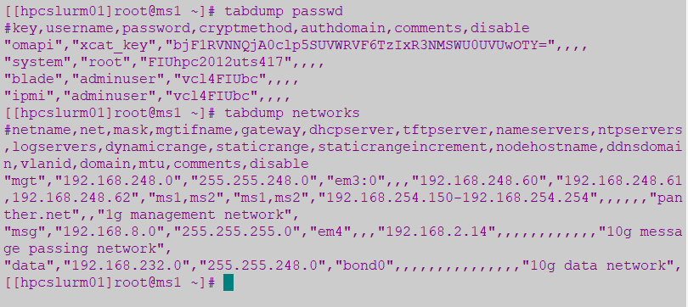
xCAT - Global Configuration

Slide 13

xCAT – Objects Definitions
Objects:
xCAT has 20 types of objects - most important are:
- Node Object: The node is the most important and used object in xCAT
- Group Object: Includes multiple node object, help handle
- Osimage Object: object represents Operating System which
multiple nodes via group. Node Inherit attributes from group
objects (rpower groupname stat vs rpower node stat)
can be deployed with xCAT (centos7.8, centos7.9)
Notes:
https://sourceforge.net/p/xcat/wiki/Listing_and_Modifying_the_Database/#database-commands-and-tables

Slide 14
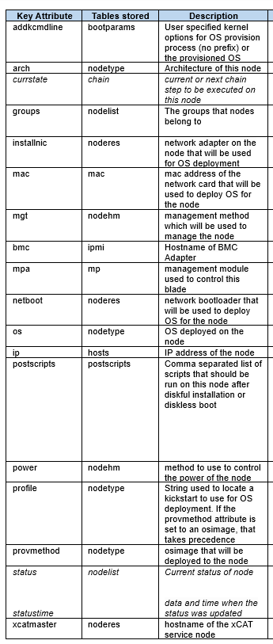
xCAT – Node Objects
Example
Object name: n132
addkcmdline=biosdevname=0 net.ifnames=0
arch=x86_64
bmc=r132
chain=runcmd=bmcsetup,osimage=alma9.5-x86_64-netboot-compute
cpucount=64
cputype=Intel(R) Xeon(R) Gold 6430
currchain=standby
currstate=netboot alma9.7-x86_64-compute
groups=alma9,hpe
hostnames=n132-ens15f1d1
installnic=mac
ip=192.168.246.202
mac=d4:04:e6:b4:8d:62|d4:04:e6:b4:8d:63!n132-ens15f1d1
memory=3096244MB
mgt=ipmi
mtm=HPE:P52499-B21
netboot=xnba
nicdevices.bond0=eth0|eth1
nicdevices.bond0.418=bond0
nicextraparams.bond0=mode=802.3ad miimon=100 ipv4.dns=192.168.246.2 ipv4.dns-search=roary.net
nichostnamesuffixes.bond0.418=-data
nicips.bond0.418=192.168.233.202
nicips.bond0=192.168.246.202
nicnetworks.bond0.418=data
nicnetworks.bond0=net427
nictypes.bond0.418=vlan
nictypes.eth0=Ethernet
nictypes.eth1=Ethernet
nictypes.bond0=bond
os=alma9.7
postbootscripts=otherpkgs
postscripts=syslog,remoteshell,syncfiles,setupntp,roary-sethostname,confignetwork,roary-repo-alma9,roary-ldap,roary-nouserlogin,roary-setuplustre,roary-slurm
profile=compute
provmethod=alma9.7-x86_64-netbootIB-compute
serial=3M1D1T10JW
status=booted
statustime=06-01-2026 14:50:29
supportedarchs=x86,x86_64
updatestatus=synced
updatestatustime=06-01-2026 14:51:59
Notes:
https://xcat-docs.readthedocs.io/en/latest/guides/admin-guides/basic_concepts/xcat_object/node.html
https://xcat-docs.readthedocs.io/en/stable/guides/admin-guides/references/man7/node.7.html

Slide 15
xCAT – Node Objects
Sample command to add a new node and set attributes values:
nodeadd n132 groups=alma9,hpe
chdef -t node n132 ip=192.168.246.202 \ mac=d4:04:e6:b4:8d:62
chdef -t node n132 netboot=xnba installnic=mac
chdef -t node n132 os=alma9.7 arch=x86_64
chdef -t node n132 addkcmdline="biosdevname=0 net.ifnames=0"
chdef -t node n132 bmc=r132 mgt=ipmi
chdef -t node n132 provmethod=alma9.7-x86_64-netbootIB-compute
chdef -t node n132 postscripts="syslog,remoteshell,syncfiles,setupntp,roary-sethostname,confignetwork,roary-repo-alma9,roary-ldap,roary-nouserlogin,roary-setuplustre,roary-slurm"

Slide 16
xCAT – Groups Objects
Compute Nodes groups currently in use:
Sample command to add a new node:
Nodes | Groups (stored on nodelist) | osimage (provmethod)
n001 | dell & 16C_128G | alma9.7-x86_64-netbootIB-compute
n003,n006-n012 | dell & 16C_128G | alma9.5-x86_64-netboot-compute
n095-n102 | alma9 & dell | alma9.5-x86_64-netboot-compute
n126-n127 | alma9 & hpe | alma9.5-x86_64-netboot-compute
n128-n133 | alma9 & hpe | alma9.7-x86_64-netbootIB-compute
gpu-a100-01..07 | raptor | alma9.5-x86_64-netboot-cudaruntime
g009 | raptor | alma9.5-x86_64-netboot-cudaruntime
login1,login2 | login,alma9,dell | alma9.5-x86_64-install-compute
dm01 | dm,alma9,dell | alma9.5-x86_64-install-compute
> nodeadd gpu-a100-01 groups=raptor,alma9
> nodeadd n126-n133 groups=alma9,hpe
Nodes | Groups (stored on nodelist)
v003 | viz & R720
Nodes | Groups
dell | Stored on noderes, nodehm tables
hpe | Stored on noderes, nodehm tables
raptor | Stored on noderes, nodehm tables
R720 | Stored on noderes, nodehm tables
Nodes | Groups
compute | Stored on nodetype table
alma9 | Stored on nodetype table
Infra Nodes | Groups
hpcslurm | slurmmn,alma9
hpcxcat | xcatmn
login1,login2 | login
dm01 | dm
l01-l03 | hpcdns
Notes:
https://xcat-docs.readthedocs.io/en/latest/guides/admin-guides/basic_concepts/xcat_object/group.html
https://xcat-docs.readthedocs.io/en/latest/guides/admin-guides/references/man7/group.7.html

Slide 17
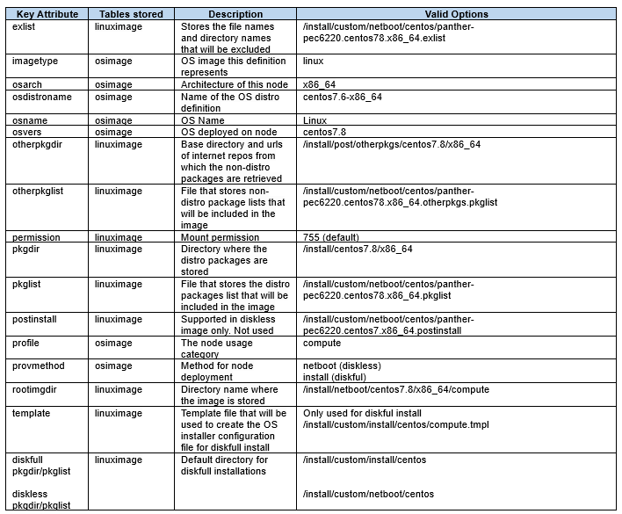
xCAT – OSimage Objects
Example 1
Object name: alma9.7-x86_64-netbootIB-compute
exlist=/opt/xcat/share/xcat/netboot/alma/compute.alma9.x86_64.exlist
imagetype=linux
kernelver=5.14.0-611.54.3.el9_7.x86_64
osarch=x86_64
osdistroname=alma9.7-x86_64
osname=Linux
osvers=alma9.7
otherpkgdir=/install/post/otherpkgs/alma9.7/x86_64
otherpkglist=/install/custom/netboot/alma/ib.alma9.7.doca.pkglist
permission=755
pkgdir=/install/alma9.7/x86_64,/install/kernels/5.14.0-611.54.3.el9_7.x86_64
pkglist=/opt/xcat/share/xcat/netboot/alma/compute.alma9.x86_64.pkglist
postinstall=/opt/xcat/share/xcat/netboot/alma/compute.alma9.x86_64.postinstall
profile=compute
provmethod=netboot
rootimgdir=/install/netboot/alma9.7/x86_64/compute-ib
11:17:21 hpcxcat /home/lenz # lsos alma9.7-x86_64-netboot-cudaruntime
Example 2
Object name: alma9.7-x86_64-netboot-cudaruntime
exlist=/opt/xcat/share/xcat/netboot/alma/compute.alma9.x86_64.exlist
imagetype=linux
kernelver=5.14.0-611.54.3.el9_7.x86_64
osarch=x86_64
osdistroname=alma9.7-x86_64
osname=Linux
osvers=alma9.7
otherpkgdir=/install/post/otherpkgs/alma9.7/x86_64
otherpkglist=/install/custom/netboot/alma/cudaruntime.alma9.7.x86_64.otherpkgs.pkglist
permission=755
pkgdir=/install/alma9.7/x86_64,/install/kernels/5.14.0-611.54.3.el9_7.x86_64
pkglist=/opt/xcat/share/xcat/netboot/alma/compute.alma9.x86_64.pkglist
postinstall=/opt/xcat/share/xcat/netboot/alma/compute.alma9.x86_64.postinstall
profile=compute
provmethod=netboot
rootimgdir=/install/netboot/alma9.7/x86_64/cudaruntime
11:17:42 hpcxcat /home/lenz # lsos alma9.7-x86_64-netboot-compute
Notes:
https://xcat-docs.readthedocs.io/en/stable/guides/admin-guides/basic_concepts/xcat_object/osimage.html
https://xcat-docs.readthedocs.io/en/latest/guides/admin-guides/references/man7/osimage.7.html

Slide 18
xCAT – OSimage Objects
OSimage definition currently used for diskless – alma9.5:
-Created:
> mkdef -t osimage -o alma9.5-x86_64-netboot-compute profile=compute imagetype=linux osarch=x86_64 osname=Linux osvers=alma9.5 permission=755 provmethod=netboot rootimgdir=/install/netboot/alma9.5/x86_64/compute pkgdir=/install/alma9.5/x86_64
-Adding package definition and directories:
> chdef -t osimage -o alma9.5-x86_64-netboot-compute exlist=/opt/xcat/share/xcat/netboot/alma/compute.alma9.x86_64.exlist otherpkgdir=/install/post/otherpkgs/alma9.5/x86_64 otherpkglist=/install/custom/netboot/alma/compute.alma9.x86_64.otherpkgs.pkglist pkglist=/opt/xcat/share/xcat/netboot/alma/compute.alma9.x86_64.pkglist postinstall=/opt/xcat/share/xcat/netboot/alma/compute.alma9.x86_64.postinstall
Command to list all osimage definitions (current & previous OS versions):
> lsdef –t osimage
See attributes of current osimage:
> lsdef –t osimage alma9.5-x86_64-netboot-compute
Assign osimage to the node to be installed:
> nodeset gpu-a100-01 osimage=alma9.5-x86_64-netboot-compute

Slide 19
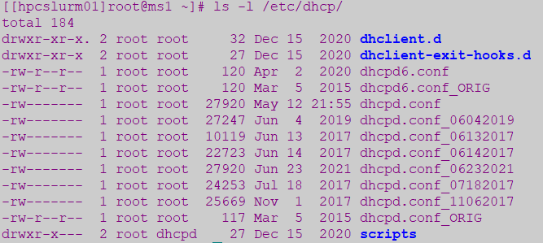
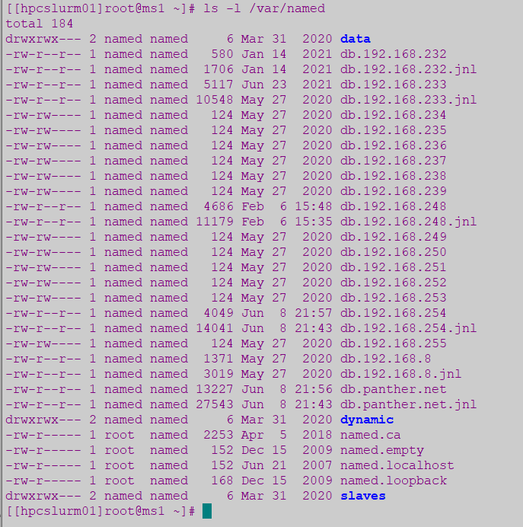
xCAT – DHCP & DNS Configuration
DHCP Service - /etc/dhcp/dhcpd.conf
> Create new dhcpd.conf file: makedhcp –n (run this once)
> Add new node to dhcp: makedhcp –a nodename
> Command to query node with DHCP: makedhcp –q gpu-a100-01
[root@hpcxcat dhcp]# makedhcp -q gpu-a100-01
gpu-a100-01: ip-address = 192.168.246.171, hardware-address = f4:c7:aa:41:65:44
DNS Service: /var/named
> Create new DNS for all the nodes: makedns –n (run this once)
> Add new node to DNS: makedns nodename
> Make host file from DNS: makehosts
> Check output in /etc/hosts file
[root@hpcxcat dhcp]# more /etc/hosts |grep gpu-a100-01
192.168.254.55 r-a100-01 r-a100-01.roary.net
192.168.246.171 gpu-a100-01 gpu-a100-01.roary.net
[root@hpcxcat dhcp]# more /etc/hosts |grep node07
192.168.233.171 gpu-a100-01 gpu-a100-01.roary.net
Notes:
https://xcat-docs.readthedocs.io/en/stable/guides/admin-guides/references/man8/makedhcp.8.html?highlight=makedhcp
https://xcat-docs.readthedocs.io/en/stable/guides/admin-guides/references/man8/makedns.8.html?highlight=makedns

Slide 20
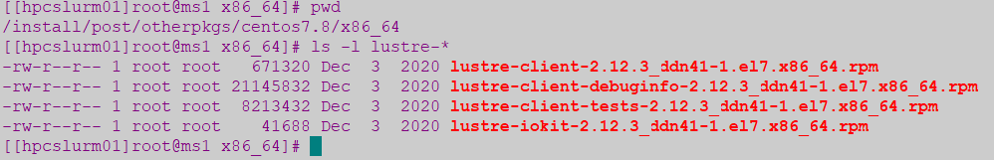
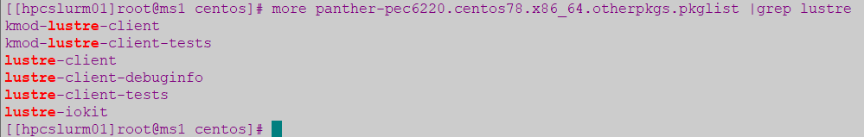
xCAT - Create repository for additional packages under /install/post/otherpkgs
Any additional packages not included on the AlmaLinux7 ISO Image can be added under a repository - /install/post/otherpkgs/alma9.5/x86_64 and it can be rebuilt as it gets updated with new RPMs
The list of additional RPM packages to install is maintained under:
/install/custom/netboot/alma/compute.alma9.x86_64.otherpkgs.pkglist
Copy all the RPMS in /install/post/otherpkgs/alma9.5/x86_64
Create initial repository - run this only once to createrepo the first time
> Createrepo /install/post/otherpkgs/alma9.5/x86_64/
Update repository - any additional rpms, use “update” with the createrepo command
> createrepo --update -v /install/post/otherpkgs/alma9.5/x86_64/
If using comps.xml (for IB Mellanox Driver)
Rebuild repo: createrepo --update -v -g comps.xml /install/post/otherpkgs/alma9.5/x86_64/
Generate new image with the new additional RPMs and pack Image for diskless install
> genimage alma9.5-x86_64-netboot-compute
> packimage alma9.5-x86_64-netboot-compute
Notes:
https://xcat-docs.readthedocs.io/en/stable/guides/admin-guides/manage_clusters/common/deployment/additionalpkg/nonubuntu_os_other_pkg.html

Slide 21
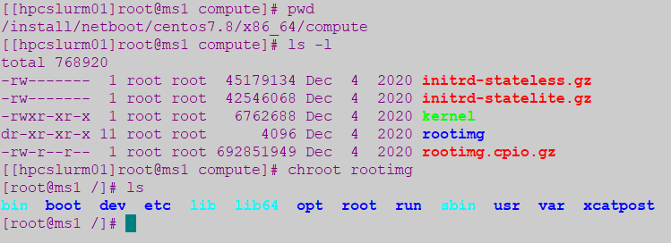
xCAT Diskless Installation (RAMdisk-based)
Create image from ISO file with copycds command under /install/alma9.5:
> copycds -n alma9.5 -a x86_64 AlmaLinux-9.5-x86_64-dvd.iso
After executing copycds, these osimage definitions are created by default:
alma9.5-x86_64-install-compute is the default osimage definition used for diskful installation
alma9.5-x86_64-netboot-compute is the default osimage definition used for diskless installation
Generate Diskless Image under /install/netboot/alma9.5/x86_64/compute
> genimage alma9.5-x86_64-netboot-compute
> Rootimg accessible can be modified before packing it with command: chroot rootimg
Pack Diskless Image from chroot FS
> packimage alma9.5-x86_64-netboot-compute
Notes:
https://xcat-docs.readthedocs.io/en/stable/guides/admin-guides/manage_clusters/ppc64le/diskless/copy_image.html
https://xcat-docs.readthedocs.io/en/stable/guides/admin-guides/manage_clusters/ppc64le/diskless/gen_image.html
https://xcat-docs.readthedocs.io/en/stable/guides/admin-guides/manage_clusters/ppc64le/diskless/customize_image/postscript_execution.html
https://sourceforge.net/p/xcat/wiki/Installing_Stateful_Linux_Nodes/
https://xcat-docs.readthedocs.io/en/latest/guides/admin-guides/references/man1/genimage.1.html?highlight=genimage
https://xcat-docs.readthedocs.io/en/latest/guides/admin-guides/references/man1/packimage.1.html?highlight=packimage

Slide 22
Preparing new compute node for xCAT provisioning
Configure DRAC/ILO on the new node:
-Assign an IP address from the DRAC/ILO MGMT VLAN 421: 192.168.254.xx
-Configure DRAC/ILO network interface with this IP and take note of the MAC address
-Enable IPMI over LAN (as Administrator)
-Create and enable user as Administrator: “adminuser” and match password defined in xCAT passwd table for the IPMI user
Capture all Network interfaces to be used and their MAC addresses from DRAC/ILO GUI:
This includes at least 2 set of MACs in addition to the DRAC interface which will be assigned for:
-MGMT VLAN 421: 192.168.246.xx
-Data VLAN 418: 192.168.233.xx
Assign IP addresses for each of this network interfaces
Assign free IPs for the 3 interfaces in the :
-DRAC/ILO interface MGMT VLAN 421: 192.168.254.xx
-MGMT VLAN 421: 192.168.246.xx
-Data VLAN 418: 192.168.233.xx
Update information in the Excel sheet (fiu_hpc_detailsv10) on OneDrive
Define the new node names with IPs assigned to be added in xCAT for host and DNS Configuration:
Follow this naming convention:
-DRAC/ILO interface used for BMC: rxxx – like r126, r-a100-01, rv003
-MGMT Interface: nxxx or gxxx or vxxx – like n125, gpu-a100-01, v003
-Data Interface: hpcnodexxx – like n126, gpu-a100-01, v003

Slide 23
Adding new compute node/group definitions in xCAT
Adding new compute node/group definitions in xCAT
Add node to groups:
nodeadd n126 groups=hpe,alma9 # HPE compute
nodeadd gpu-a100-01 groups=raptor,alma9 # GPU/Raptor
nodeadd r126 groups=mgt # BMC/DRAC
HPE compute node (n126) — key attributes:
chdef -t node n126 ip=192.168.246.196 mac=d4:04:e6:06:04:ac
chdef -t node n126 netboot=xnba installnic=mac
chdef -t node n126 os=alma9.5 arch=x86_64 mgt=ipmi bmc=r126
chdef -t node n126 xcatmaster=hpcxcat
chdef -t node n126 addkcmdline="biosdevname=0 net.ifnames=0"
chdef -t node n126 postscripts="syslog,remoteshell,syncfiles,setupntp,
roary-sethostname,confignetwork,roary-repo-alma9,roary-ldap,
roary-nouserlogin,roary-setuplustre,roary-slurm"
chdef -t node n126 postbootscripts=otherpkgs
(Full bond0/VLAN NIC config: see xCAT Admin Guide)
GPU node (gpu-a100-01) — key attributes:
chdef -t node gpu-a100-01 ip=192.168.246.171 mac=f4:c7:aa:41:65:44
chdef -t node gpu-a100-01 netboot=xnba os=alma9.5 arch=x86_64
chdef -t node gpu-a100-01 mgt=ipmi bmc=raptor01b xcatmaster=hpcxcat
chdef -t node gpu-a100-01 postscripts="syslog,remoteshell,syncfiles,
setupntp,confignetwork,roary-ldap,roary-nouserlogin,
roary-setuplustre,roary-slurm"
chdef -t node gpu-a100-01 postbootscripts=otherpkgs
Nodes | Groups (stored on nodelist)
n001 | dell & 16C_128G
n003,n006-n012 | dell & 16C_128G
n095-n102 | alma9 & dell
n126-n127 | alma9 & hpe
n128-n133 | alma9 & hpe
gpu-a100-01..07 | raptor
g009 | raptor
login1,login2 | login,alma9,dell
dm01 | dm,alma9,dell

Slide 24
Update DHCP & DNS with new compute node
Add new node to dhcp:
makedhcp -a gpu-a100-01 | makedhcp -a r-a100-01
makedhcp -a n126 | makedhcp –a n126 | makedhcp –a r126
To Query:
makedhcp –q gpu-a100-01
Add new node to DNS to update /etc/hosts file:
makedns gpu-a100-01
makedns r-a100-01
makedns gpu-a100-01
makehosts

Slide 25
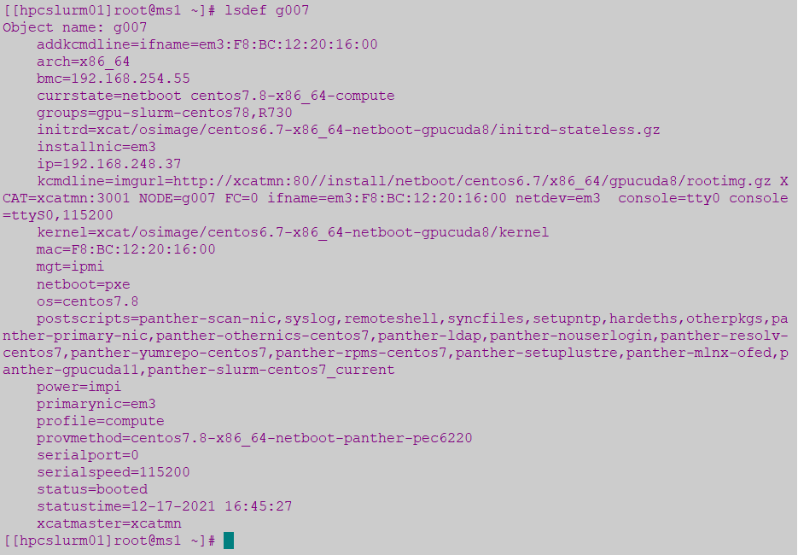
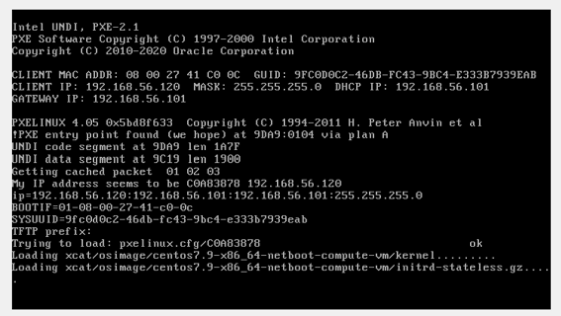
Set the boot state for the node/noderange
List current definition command:
lsdef gpu-a100-01
Set the boot state for the node with nodeset command:
nodeset gpu-a100-01 osimage= alma9.5-x86_64-netboot-compute
rpower gpu-a100-01 stat
rpower gpu-a100-01 reset
Note:
Note: nodeset writes boot config to /tftpboot/xcat/xnba/nodes/
Notes:
https://xcat-docs.readthedocs.io/en/latest/guides/admin-guides/references/man8/nodeset.8.html
https://xcat-docs.readthedocs.io/en/latest/guides/admin-guides/references/man1/rpower.1.html?highlight=rpower
https://xcat-docs.readthedocs.io/en/latest/guides/admin-guides/references/man8/rinstall.8.html?highlight=rinstall
https://xcat-docs.readthedocs.io/en/stable/guides/admin-guides/references/man1/xdsh.1.html
https://xcat-docs.readthedocs.io/en/stable/guides/admin-guides/manage_clusters/ppc64le/parallel_cmd.html

Slide 26
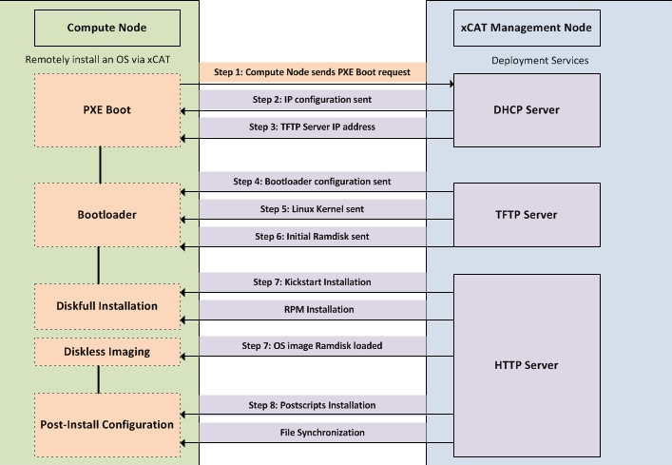
xCAT Node Installation Process

Slide 27
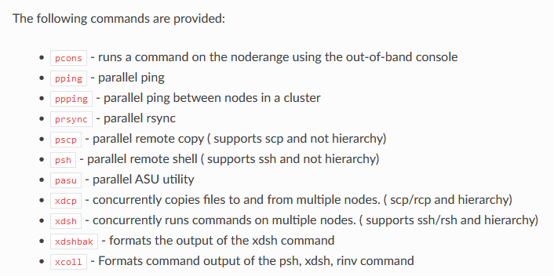
Parallel Commands from xCAT Management node
xCAT provides a set of commands that can run common remote commands
xdsh - Concurrently runs remote commands on multiple nodes:
xdsh n095-n102 umount -t lustre /home /scratch
xdsh n001 “df –h”
Notes:
https://xcat-docs.readthedocs.io/en/latest/guides/admin-guides/references/man8/nodeset.8.html
https://xcat-docs.readthedocs.io/en/latest/guides/admin-guides/references/man1/rpower.1.html?highlight=rpower
https://xcat-docs.readthedocs.io/en/latest/guides/admin-guides/references/man8/rinstall.8.html?highlight=rinstall
https://xcat-docs.readthedocs.io/en/stable/guides/admin-guides/references/man1/xdsh.1.html
https://xcat-docs.readthedocs.io/en/stable/guides/admin-guides/manage_clusters/ppc64le/parallel_cmd.html

Slide 28
xCAT – Backup/Restore xCAT DB Tables
Backup:
dumpxCATdb: Dump all xCAT db tables to CSV files under specified directory (often used for xCAT reinstallation or migration)
Daily cron job to backup DB tables (7 days kept in /home/share/scripts/xCAT/compressed)
## Backup xCAT Database on ms1 - Daily ##
0 4 * * * /home/share/scripts/xCAT/xCATdump.sh
To dump the xCAT database into backup directory, including the auditlog and eventlog enter:
dumpxCATdb -a -p /home/share/scripts/xCAT/ms1-dump-yy-dd-mm
Restore:
-restorexCATdb: Restore all xCAT db tables from CSV files under specified directory
-To restore the xCAT database from backup directory, including the auditlog and eventlog enter:
restorexCATdb -a -p /home/share/scripts/xCAT/hpcxcat-dump-yy-dd-mm
Notes:
https://xcat-docs.readthedocs.io/en/stable/guides/admin-guides/references/man1/dumpxCATdb.1.html
https://xcat-docs.readthedocs.io/en/stable/guides/admin-guides/references/man1/restorexCATdb.1.html

Slide 29
Cleanup retired Nodes on xCAT
Keep a backups of xCAT DB and DHCP/DNS configuration before removing entries
> dumpxCATdb -a -p "/home/share/scripts/xCAT/hpcxcat-dump_mmddyy
> cp –pr /etc/dhcp/dhcpd.conf /etc/dhcp/dhcpd.conf_mmddyy
> cp –pr /etc/hosts /etc/hosts_mmddyy
> cp –pr /var/lib/dhcpd/dhcpd.leases /var/lib/dhcpd/dhcpd.lease_mmddyy
Remove nodes from DNS
> makedns –d nodename
> makehosts (to update /etc/hosts file)
> Restart “named” services if entries not removed from DNS
Remove nodes from DHCP
> makedhcp –d nodename
Remove nodes from xCAT
> rmdef –t node nodename

Slide 30
Additional Material about xCAT
xCAT Guide:
https://xcat-docs.readthedocs.io/en/stable/index.html
https://xcat-docs.readthedocs.io/en/latest/guides/admin-guides/basic_concepts/xcat_db/index.html
https://xcat-docs.readthedocs.io/en/latest/guides/admin-guides/basic_concepts/xcat_object/index.html
https://sourceforge.net/p/xcat/wiki/Listing_and_Modifying_the_Database/#node-group-support-in-the-xcat-tables
https://sourceforge.net/p/xcat/wiki/Listing_and_Modifying_the_Database/#database-commands-and-tables
https://xcat-docs.readthedocs.io/en/latest/guides/admin-guides/basic_concepts/xcat_object/node.html
https://xcat-docs.readthedocs.io/en/stable/guides/admin-guides/references/man7/node.7.html
https://xcat-docs.readthedocs.io/en/latest/guides/admin-guides/basic_concepts/xcat_object/group.html
https://xcat-docs.readthedocs.io/en/latest/guides/admin-guides/references/man7/group.7.html
https://xcat-docs.readthedocs.io/en/stable/guides/admin-guides/basic_concepts/xcat_object/osimage.html
https://xcat-docs.readthedocs.io/en/latest/guides/admin-guides/references/man7/osimage.7.html
https://xcat-docs.readthedocs.io/en/stable/guides/admin-guides/references/man8/makedhcp.8.html?highlight=makedhcp
https://xcat-docs.readthedocs.io/en/stable/guides/admin-guides/references/man8/makedns.8.html?highlight=makedns
https://xcat-docs.readthedocs.io/en/stable/guides/admin-guides/manage_clusters/ppc64le/diskless/copy_image.html
https://xcat-docs.readthedocs.io/en/stable/guides/admin-guides/manage_clusters/ppc64le/diskless/gen_image.html
https://xcat-docs.readthedocs.io/en/stable/guides/admin-guides/manage_clusters/ppc64le/diskless/customize_image/postscript_execution.html
https://xcat-docs.readthedocs.io/en/latest/guides/admin-guides/references/man1/genimage.1.html?highlight=genimage
https://xcat-docs.readthedocs.io/en/latest/guides/admin-guides/references/man1/packimage.1.html?highlight=packimage
https://xcat-docs.readthedocs.io/en/latest/guides/admin-guides/references/man8/nodeset.8.html
https://xcat-docs.readthedocs.io/en/latest/guides/admin-guides/references/man1/rpower.1.html?highlight=rpower
https://xcat-docs.readthedocs.io/en/stable/guides/admin-guides/references/man1/dumpxCATdb.1.html
https://xcat-docs.readthedocs.io/en/stable/guides/admin-guides/references/man1/restorexCATdb.1.html

Slide 31


Questions & Answers

